Slide 1
Evaluating Response, Revenue, and Risk to Inform Campaign Targeting
Who Responds, Who Spends, and Where Campaigns Break Down

Slide 2
Business Context and Objective
Marketing campaigns drive engagement, but not all customers respond equally
Discounts and omnichannel strategies may increase response at the cost of margin or complaints
Goal: identify who responds, who generates value, and where campaigns should focus
This analysis evaluates campaign effectiveness, customer value, and risk to inform targeting strategy.

Slide 3
Data Overview
Includes:
2,200 customers
Timeframe: 2012–2014
Key dimensions:
  Customer demographics
  Purchase behavior
  Channel usage
  Campaign response & complaints

Slide 4
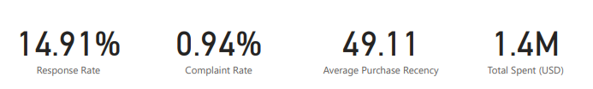
Overall Campaign Performance
Response and complaints both declined from 2012–2014
Despite lower engagement, total spend increased

Slide 5
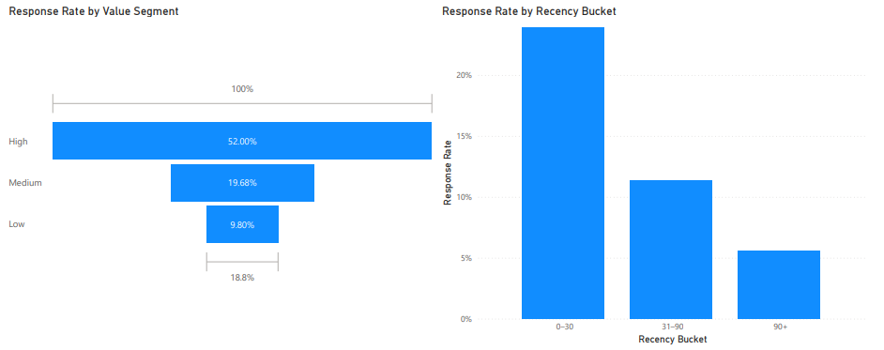
Who Responds?
High-value customers show the highest response rate
Customers purchasing within 0–30 days respond significantly more than inactive customers

Slide 6
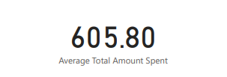
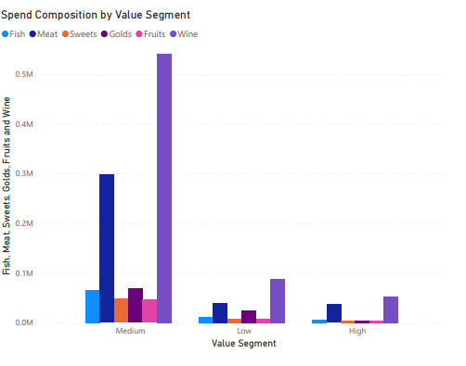

Who Actually Generates Value?
Medium-value customers generate the highest total spend
High-value customers respond more but contribute less total revenue than expected

Slide 7
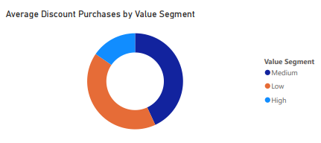
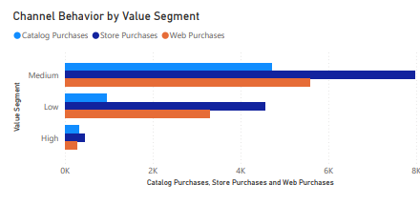
Discount & Channel Behavior
Medium-value customers use discounts most frequently
Store and web channels dominate across segments

Slide 8
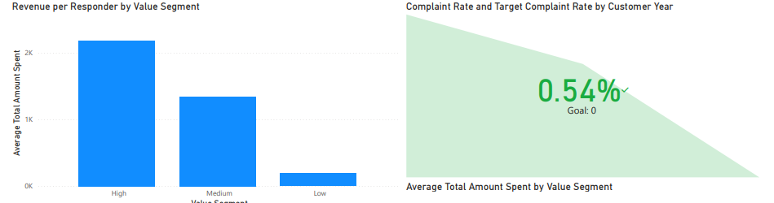
Revenue vs Risk Tradeoff
High-value responders generate the most revenue per responder
Complaint rate remains low overall (~1%), below risk threshold

Slide 9
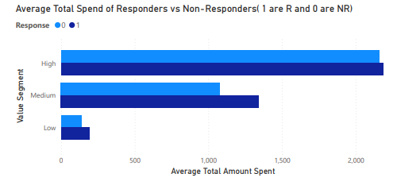
Do Incentives Actually Move Revenue?
Responders spend more than non-responders across all segments
Impact is strongest among high-value customers

Slide 10

Conclusion
High-value customers respond most but are not the top revenue drivers
Medium-value customers generate the highest total spend and discount usage
Campaigns favor recently active customers over dormant ones
Complaint risk remains low despite targeting and incentives

Slide 11

Recommendations
Target:
High and medium-value customers
Recently active (0–30 days)
Omnichannel users
Deprioritize:
Long-inactive customers
Discount-heavy low spenders

Slide 12
Next Steps
Test
Test reduced discounting for high-value customers
Segment
Segment medium-value customers by product mix
Evaluate
Evaluate long-term LTV vs short-term response

